Slide 1
Image Classification Using
Different Neural Networks
Ikechukwu Ukonze, Violeta Rojas Bazan, Nishanta Baral, Iyanuoluwa Shode
Notes:
Image Classification Using
Different Neural Networks

Slide 2
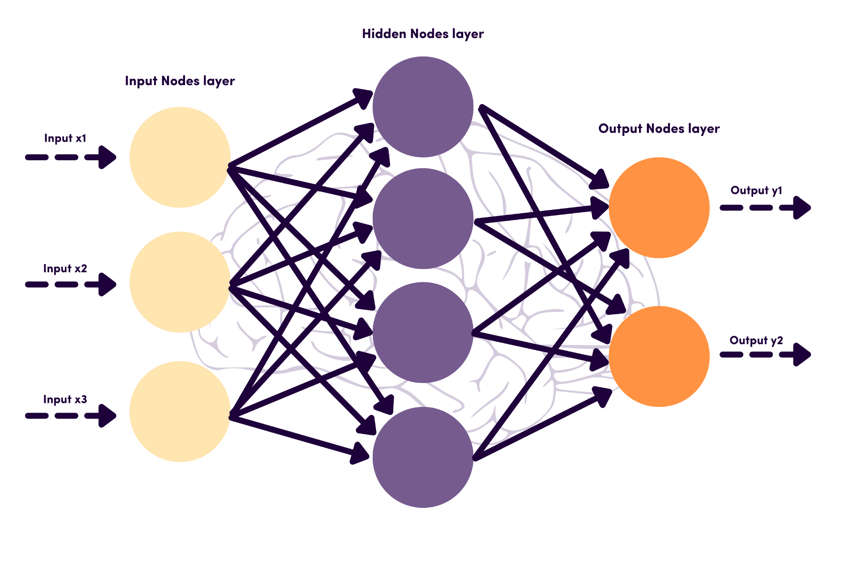
Artificial Neural Networks (ANN)
Artificial Neural Networks are commonly confused with neural networks. However, they are not the same thing.
An ANN, on the other hand, is a form of neural network. Because information passes from one layer to the next without touching a node twice, ANN is essentially a feed-forward network.
This neural system, which is based on how neurons behave in the brain, recognizes patterns in raw data and assists in the resolution of complex processes.
Another parallel with the human brain is that the ANN improves with each new input. In a nutshell, ANN improves independently — or is always improving.
The ANN is made up of three or more layers of interconnected nodes, analogous to the brain.
Input, processing, and output data to the deeper layers are the responsibility of all layers. This neural network understands and learns complex things thanks to an inter-layered system like this.
Fig. A How artificial neural networks work [1]
Notes:
As learned in Class,
Form of Neural Network. ANN is a feed-forward network.
Modelled after the human brain and how neurons operate.
3 layers Input, processing and output.

Slide 3
ANN (Continued)
What should you use ANNs for?
Owing to its tiered layering, the ANN is used in technology focusing on complex problem solving such as pattern recognition problems.
Examples include:
Predictive analysis for business intelligence
Speech-to-text transcription application
Handwriting and facial recognition
Spam email detection
Weather prediction
Advantages & challenges of using an ANN
ANNs can bring many perks with their use, here are some of the main ones:
Adaptive nature.
Enhanced learning ability.
Gradual corruption.
Distributed information storage.
Challenges associated with ANN include::
It takes copious amounts of data to train an ANN.
Difficulty training the network.
The architecture can be fuzzy.
Notes:
Adaptive nature. Meaning: After the first training, the neural network adapts to the new information it encounters.
Enhanced learning ability: The ANN can learn events on its own once it has been trained. By comparing the problem to similar instances, it can also make decisions or generate outcomes. ANNs can accomplish numerous jobs at once due to their node strength.
Gradual corruption: A fault in one or a few cells in the ANN does not prevent it from producing output. This feature not only makes the neural network fault-tolerant, but it also means that corruption occurs slowly. In truth, it happens gradually, so you don't have to deal with an issue right once.
Distributed information storage: Unlike typical programming, the ANN saves data across the entire network rather than in a single database. Another reason it's fault-tolerant is because of this. A few missing pieces of data in one location do not bring the entire system down, but they are viewed as outliers.
It takes copious amounts of data to train an ANN: The training involves giving the network input and telling it what the output should be.
Difficulty training the network: There is no set rule for establishing the structure of artificial neural networks; getting it correctly typically requires trial and error.
The architecture can be fuzzy: When ANN provides a solution to a problem, it does not explain why or how this answer was obtained.

Slide 4
Convolution Neural Networks (CNN)
Image and video recognition, recommendation systems, and image analysis and classification are all applications of convolutional neural networks.
Previously, detecting things and recognizing patterns in photos required human labor. CNN, on the other hand, has aided in the scaling of the process by identifying patterns in images using linear algebra concepts.
So, how do CNNs function? CNNs are made up of three layers. These are they:
Convolutional layer
Pooling layer
Fully-connected layer
The CNN's complexity in comprehending the image grows with each layer. This means that the first layers of a picture interpret simple elements like edges and colors. The network can distinguish complicated elements such as object forms as the image progresses through layers. The deepest layer can finally recognize the target object.
Notes:
Add Notes*** Will discuss Convolution layer and Pooling layer used in experiment.

Slide 5
Convolutional Layer
The first layer of a Convolutional Neural Network is always a Convolutional Layer. Convolutional layers apply a convolution operation to the input, passing the result to the next layer [2].
A convolution combines the values of all the pixels in its receptive area. If you apply a convolution to an image, for example, you will reduce the image size while also combining all of the information in the field into a single pixel.
The convolutional layer’s final output is a vector. We can employ several types of convolutions depending on the problem we're trying to solve and the features we want to learn.
The 2D Convolution Layer
The 2D convolution layer is the most frequent type of convolution and is generally abbreviated as conv2D. In a conv2D layer, a filter or kernel "slides" through the 2D input data, executing element-wise multiplication.
As a result, the findings will be summed into a single output pixel. For each point it slides over, the kernel will do the same procedure, changing a 2D matrix of features into a different 2D matrix of features.
Notes:
Add Notes*** There are other convolutional layer types but we will discuss the 2D Convolutional layer because that was used with the python Tensorflow/Keras library

Slide 6
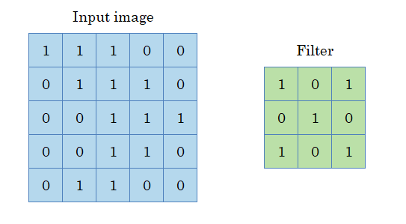
Convolutional Layer (Continued)
Fig. B Image color density with filter [3]
Notes:
Remember that any image can be represented as a matrix of pixels, with each pixel representing a color intensity

Slide 7
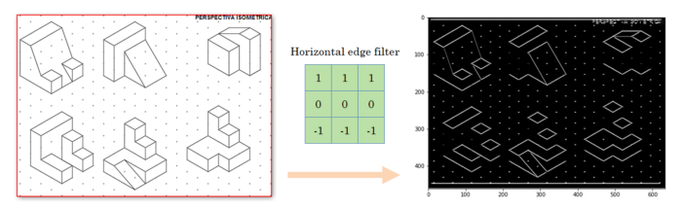
Convolutional Layer (Continued)
Fig. C Applying horizontal edge filter [3]
Notes:
If you look closely at the result, you will see that the vertical lines are removed, but the horizontal ones are kept. But an interesting detail is that, since this image is in isometric perspective, there is not a single pure horizontal line.
However, the convolution is able to handle the perspective and is showing the lines that are, in fact, horizontal, although the perspective doesn’t show them like that.

Slide 8
Pooling Layer
A pooling layer is a new layer added after the convolutional layer [4].
A popular method for ordering layers within a convolutional neural network that may be repeated one or more times in a given model is to add a pooling layer after the convolutional layer.
The pooling layer works on each feature map separately to build a new set of pooled feature maps with the same number of features.
Pooling is similar to applying a filter to feature maps in that it entails selecting a pooling procedure. The pooling operation or filter is usually smaller than the feature map; for example, it is almost always 2X2 pixels applied with a 2 pixel stride.
This means that the pooling layer will always shrink each feature map by a factor of two, halving each dimension and halving the amount of pixels or values in each feature map. A pooling layer applied to a feature map of 6X6 (36 pixels), for example, will yield an output pooled feature map of 3X3 pixels (9 pixels).
Instead of being taught, the pooling procedure is defined. The following are two popular functions used in pooling:
Average Pooling: Calculate the average value for each feature map patch.
Maximum Pooling (or Max Pooling): Calculate the maximum value for each feature map patch.
Notes:
Add Notes***

Slide 9
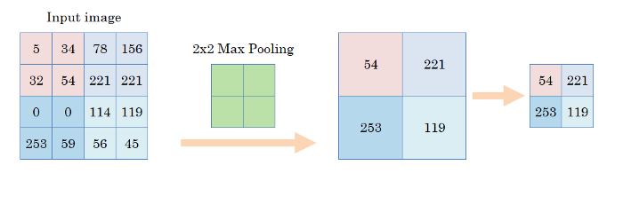
Pooling Layer (Continued)
Enhancing the power of convolutions
Fig. D Applying 2X2 Max Pooling [3]
Notes:
Add Notes***

Slide 10
CNN (Continued)
What should you do with CNNs?
This form of neural network is commonly employed in computer vision.
In essence, computer vision is an AI field that identifies meaningful information from visual inputs, such as photographs and movies. For instance, recognizing dogs from a collection of photos.
Several uses for CNN-powered computer vision include:
Recommend items that will go well with an existing item or clothing.
As social media platforms do, provide ideas for tagging people in photos.
Identify items in the same way that computer vision currently assists clinicians in recognizing cancerous tumors.
Advantages & challenges of using an CNN
CNNs have one significant advantage:
It automatically detects features without human supervision.
There are two major disadvantages to it:
Difficulty in dealing with variance in the data presented.
Computationally demanding.

Slide 11

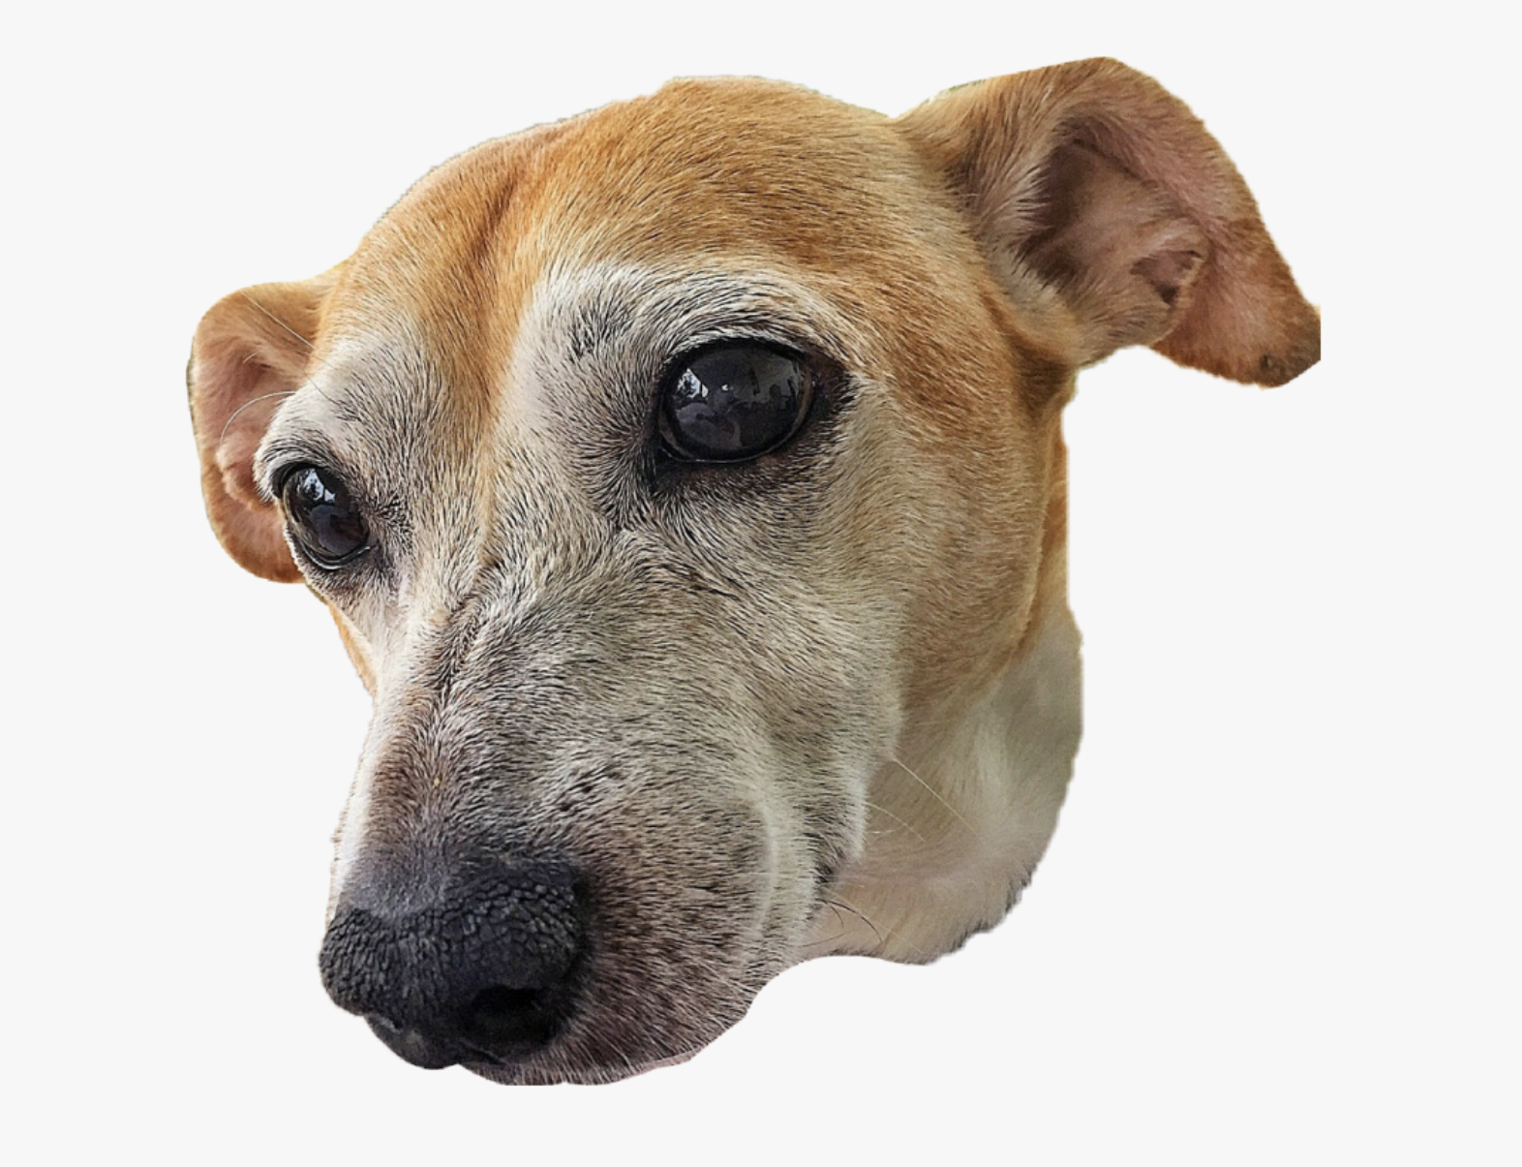
Dataset
CATS OR DOGS?
Cat is to meow as Dog is to bark.
These two animals are the most common pets in modern households. Based on the statistics from Insurance Information Institute, 68% of U.S. households own a pet which is estimated to be a total of 85 million families in the United States.
Our dataset is balanced with about 12500 cat and dog images respectively. It was downloaded from Kaggle.
Our focus is to perform a binary classification task that can differentiate and classify the pets by observing the characteristics or features each pet possess based on the available images. We see that although both pets have similar features like four legs, two eyes, two ears and so on, there are still noticeable differences between them, for instance, dogs have pointed, flopped or pricked ears while cats have more pronounced whiskers.
Notes:
About 25,000 pictures of dogs and cats where downloaded from Kaggle.

Slide 12
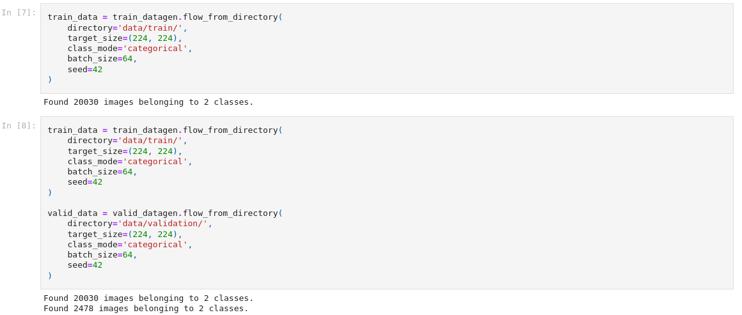
Implementing CNN training to Dataset

Slide 13
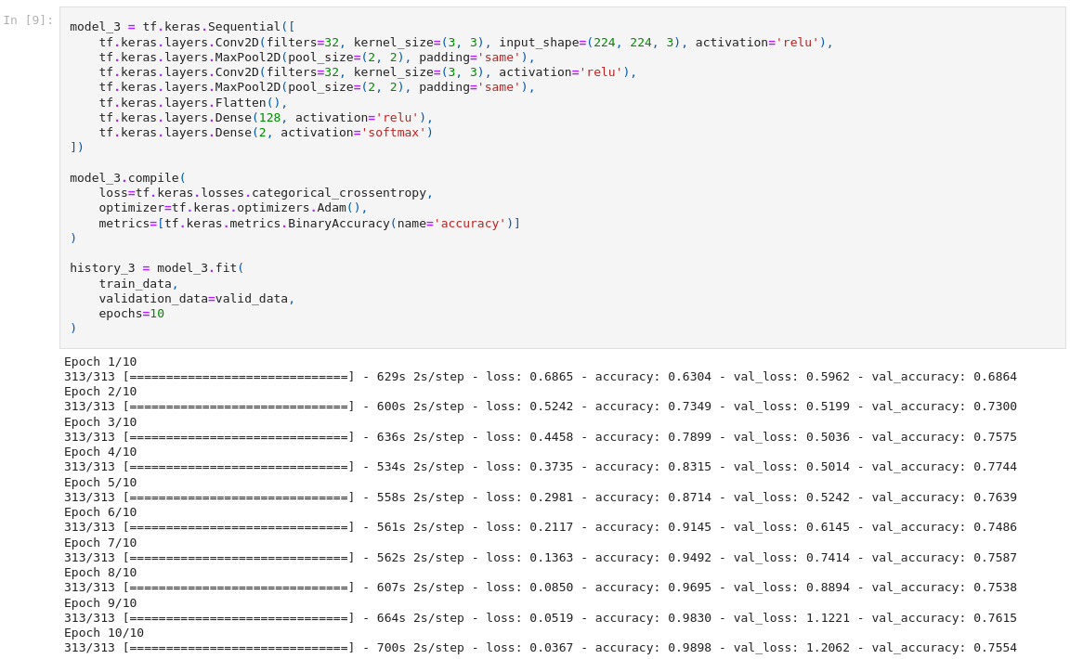
Implementing CNN training to Dataset (Continued)

Slide 14
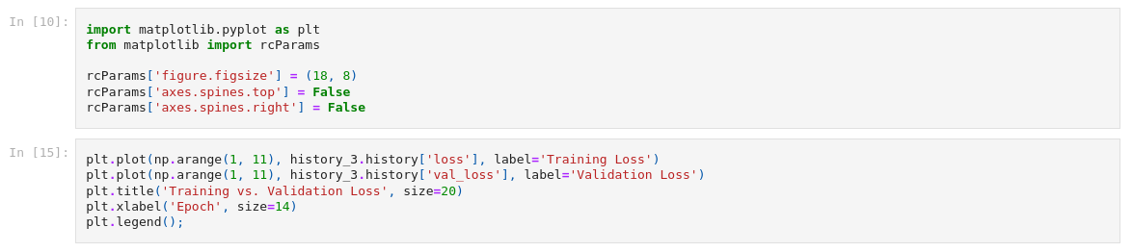
Implementing CNN training to Dataset (Continued)

Slide 15
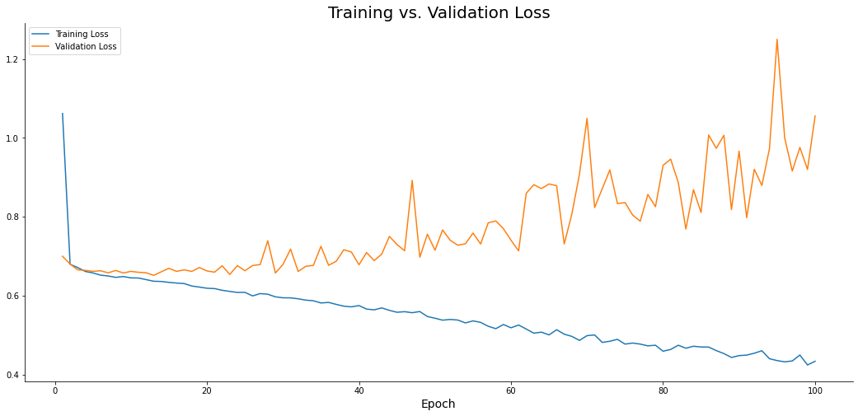
Plotting the Model Continued (100 Epoch) ANN

Slide 16
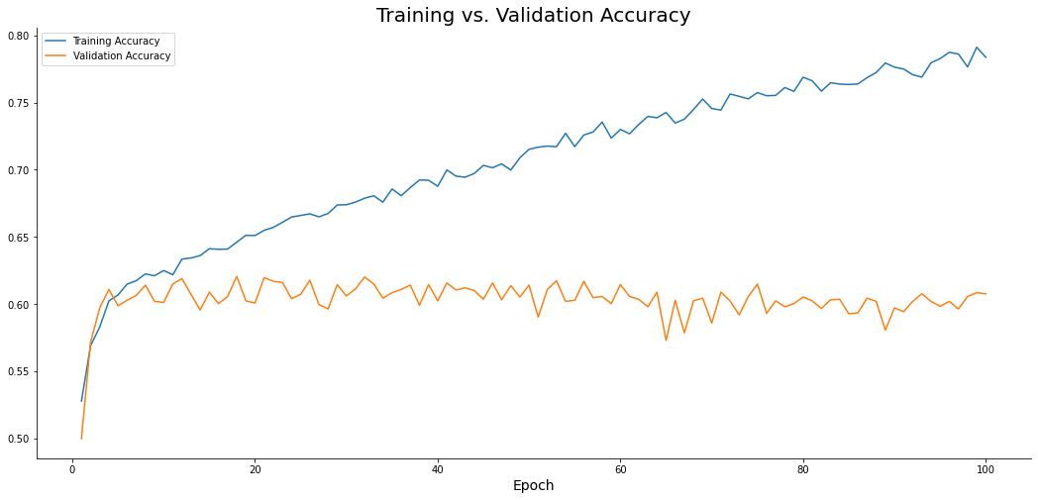
Plotting the Model Continued (100 Epoch) ANN
Notes:
Accuracy rises to about 78% for training and plateaus for the validation : Time to run 30mins

Slide 17
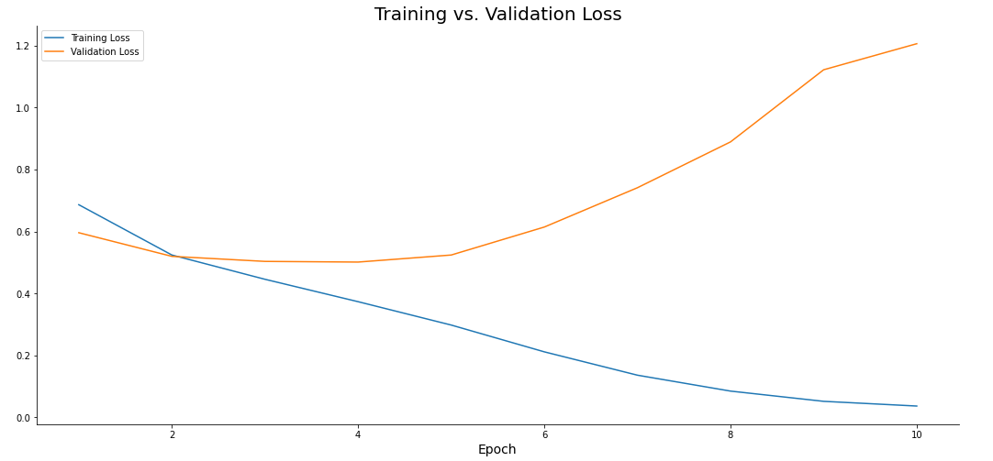
Plotting the Model Continued (10 Epoch) CNN
Notes:
Loss drops to below 10% for training and rises for validation : Time to run 2hrs

Slide 18
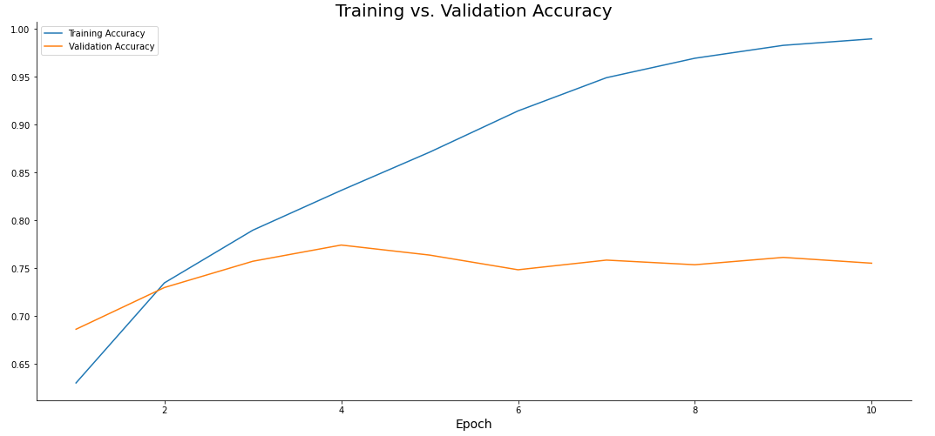
Plotting the Model Continued (10 Epoch) CNN
Notes:
Accuracy rises to about 95% for training and plateaus about 75% for the validation : Time to run 2hrs

Slide 19
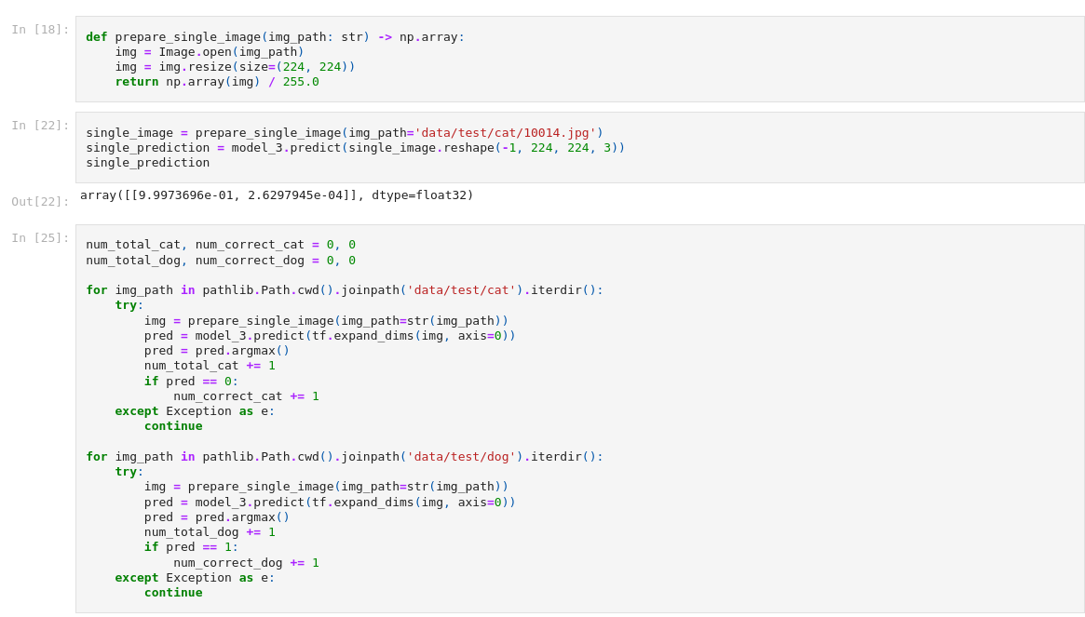
Predicting Images

Slide 20
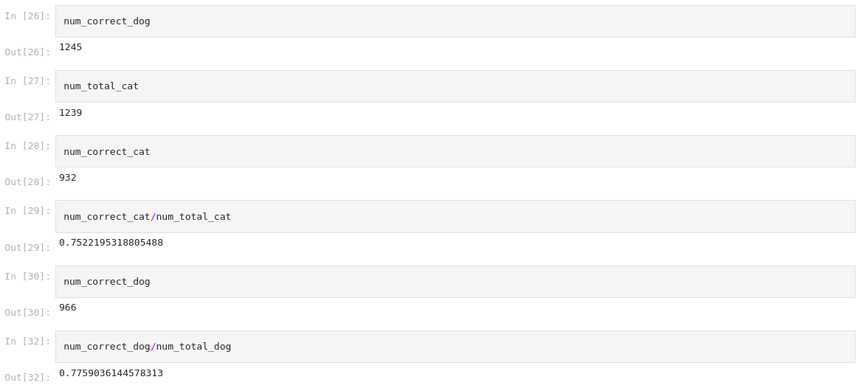
Predicting Images

Slide 21
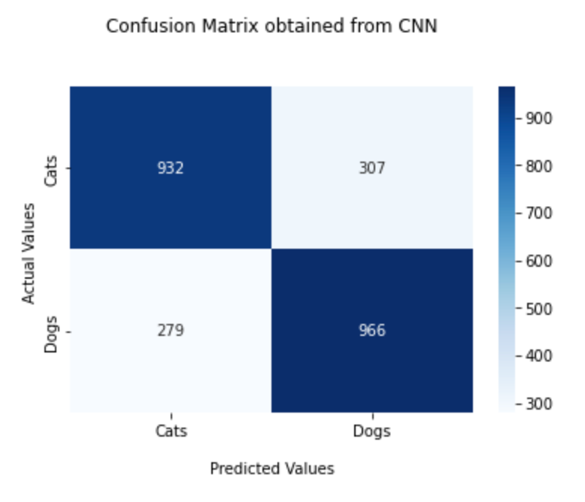
Confusion Matrix (CNN)

Slide 22
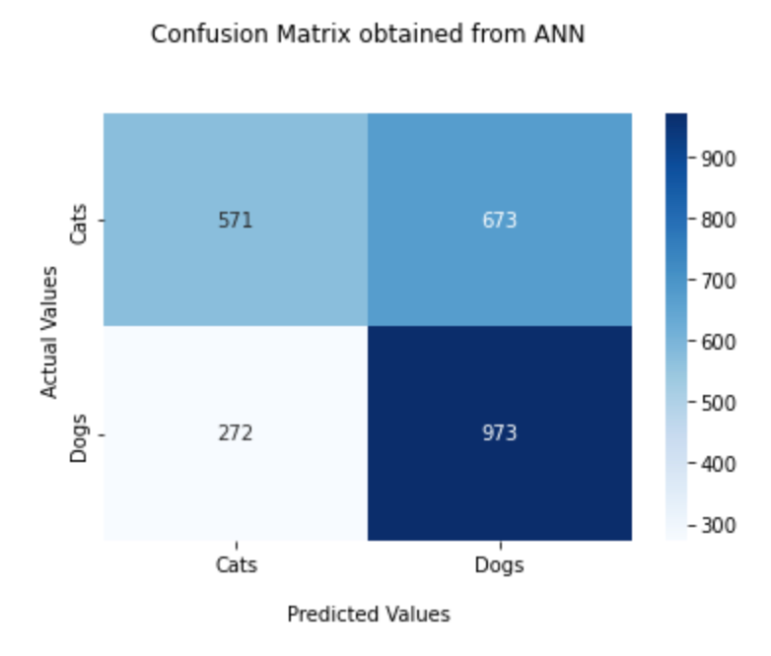
Confusion Matrix (ANN)

Slide 23
Principal Component Analysis (PCA)
Principal Component Analysis (PCA) is defined as an orthogonal linear transformation that transforms the data to a new coordinate system such that the greatest variance by some scalar projection of the data comes to lie on the first coordinate (called the first principal component), the second greatest variance on the second coordinate, and so on. Mathematically, all we are doing in a PCA is expanding the solution in an orthonormal basis which diagonalizes the underlying system. In simple terms, PCA is a dimensionality-reduction method that reduces the dimensionality of large data sets, by transforming a large set of variables into a smaller one that still contains most of the information in the large set.
The concept of PCA can be performed in 5 substeps.
Standardization: The first step in doing a PCA is to standardize the data. The reason for this is to eliminate variance of initial variables. Variance can skew the contribution that each component provides to analysis. If all of the variables are transformed to same scale, they will contribute equally to the analysis.
Notes:
Statistical technique of summarizing large data tables into smaller summary indices. Applied in image analysis to reduce size of images without affecting details contain in the pixels.

Slide 24
PCA (Continued)
Computation of covariance matrix: We compute a covariance matrix to investigate the relationship between the variables in an input data set. Large covariance means two events have large redundancy while small covariance means little redundancy. The covariance matrix is a $p × p$ symmetric matrix (where p is the number of dimensions) that has as entries the covariances associated with all possible pairs of the initial variables.
Compute the eigenvalue and eigenvector of covariance matrix to compute the principal components: Principal components are the linear combinations of the initial variables in such a way that the principal components are uncorrelated and most of the information within the initial variables is squeezed or compressed into the first components. The first principal component accounts for the largest possible variance in the dataset. The eigenvectors of covariance matrix $C_{x}$ gives us the directions of the axes where there is the most variance, and eigenvalues gives the amount of variance carried in each principal component.
Feature vector: Computing the eigenvectors and ordering them by their eigenvalues in descending order, allow us to find the principal components in order of significance. In this step, we choose whether to keep all these components or discard those of lesser significance (of low eigenvalues). So, the feature vector is simply a matrix that has as columns the eigenvectors of the components that we decide to keep.
Recast the data along the principal component axes: In this step, the aim is to use the feature vector formed using the eigenvectors of the covariance matrix, to reorient the data from the original axes to the ones represented by the principal components.

Slide 25
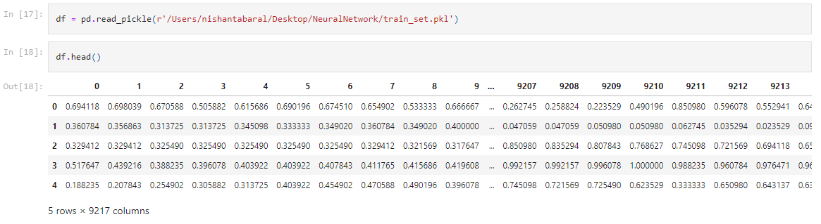
Importing data in a pickle file
Notes:
Get data for training from previous logic

Slide 26
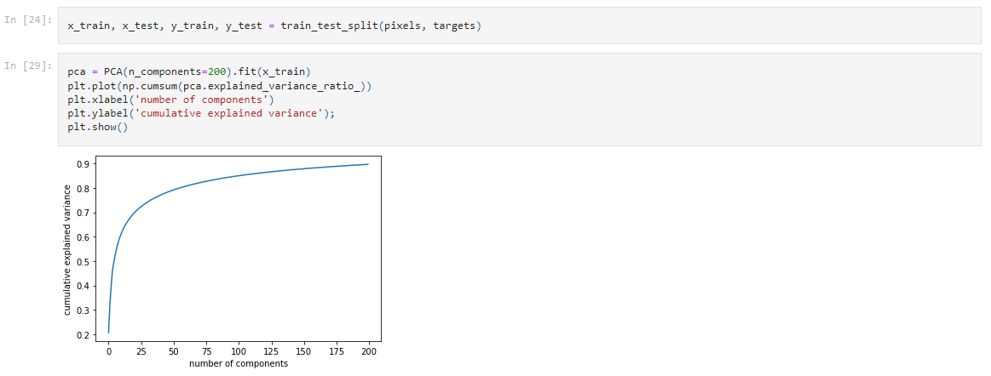
Using 200 components for training
Notes:
PCA improves training time. About 15 mins

Slide 27
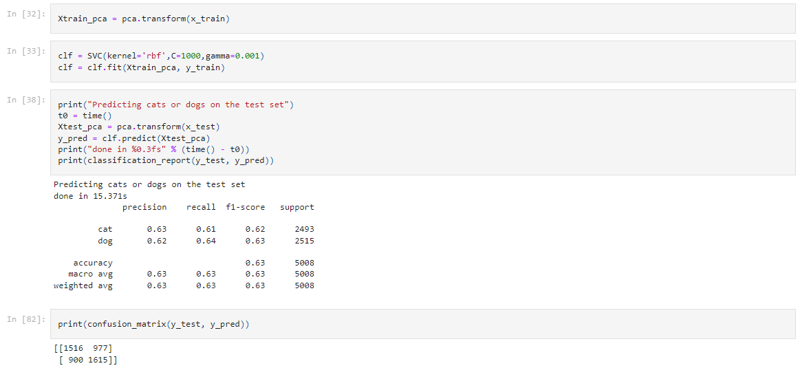
Making Predictions

Slide 28
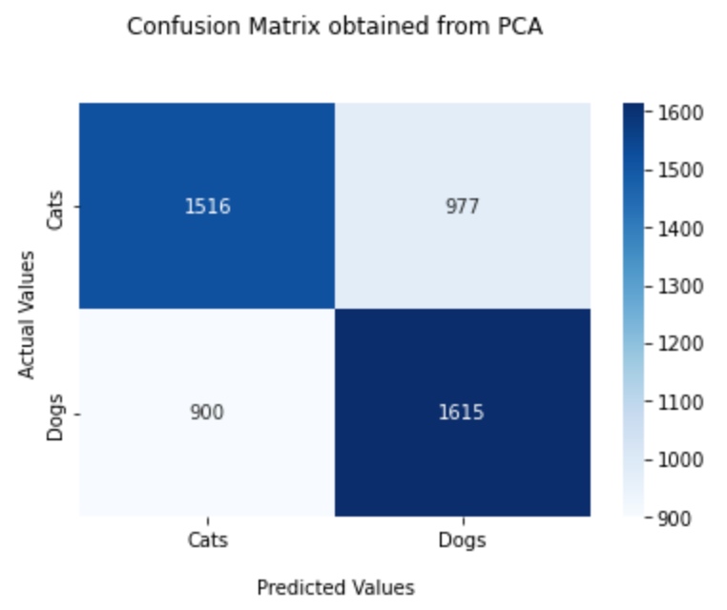
Confusion Matrix (PCA)

Slide 29
Conclusion
ANN is a feed forward Algorithm that has a significant amount of drawbacks especially with requiring large amounts of data and heavily relying on trial and error technique.
CNN on the other hand introduces several layers to the training module such as pooling and convolution that improves prediction by requiring less human supervision.
Both methods requires a large amount of resource and time to train datasets.
However the introduction of PCA subsequently improves the time it takes to train these by reducing the image data substantially without having to distort information contained in the images.

Slide 30
References
[1] Memon, M. (2022, April 11). Neural networks: CNN vs ANN VS RNN. Levity. Retrieved May 11, 2022, from https://levity.ai/blog/neural-networks-cnn-ann-rnn
[2] What is a convolutional layer? Databricks. (2020, May 15). Retrieved May 11, 2022, from https://databricks.com/glossary/convolutional-layer
[3] Zafra, M. F. (2020, May 25). Understanding convolutions and pooling in Neural Networks: A simple explanation. Medium. Retrieved May 11, 2022, from https://towardsdatascience.com/understanding-convolutions-and-pooling-in-neural-networks-a-simple-explanation-885a2d78f211
[4] Brownlee, J. (2019, July 5). A gentle introduction to pooling layers for Convolutional Neural Networks. Machine Learning Mastery. Retrieved May 11, 2022, from https://machinelearningmastery.com/pooling-layers-for-convolutional-neural-networks/

